Slide 1
Digital System Design CE 325 L1 SPRING 2024
Instructor : Dr. Syed Arsalan Jawed
Associate Professor of Practice
arsalan.jawed@sse.habib.edu.pk
Room : W-301
Office Hours : Monday 0930-1030, Wednesday 1430-1530, Friday 0930-1030

Slide 2
Installing and Using Open Source Synthesis Tool Yosys
Download OSS_CAD***.EXE for Windows 11 from the following link
https://yosyshq.net/yosys/download.html
Place the .exe in an appropriate folder and launch.
Enable Developer Mode in Windows for the installation.
Open CMD as Admin. Go to the folder where .exe was placed. Go inside OSS_CAD folder.
Execute the following batch files
Environment <enter>
Start
This will open a new terminal
Yosys is now installed.

Slide 3
For Documents and Reps
https://yosyshq.readthedocs.io/projects/yosys/en/latest/getting_started/example_synth.html#demo-design
The original manual of Yosys in pdf
https://yosyshq.net/yosys/files/yosys_manual.pdf
Read 1.1 to know about history of Yosys and OpenSource tools.
We will refer to this document as Yosys Manual Pdf in the slides.

Slide 4
Three parts of Synthesis
Compliance with HDLs Standards
Handling behavioral description
Optimizations
Coarse Levels : at adders/multipliers level
Fine Levels : at single bit gates level
Technology Mapping
Converting the design into a netlist of cells available in the target architecture
FPGA : CLBs, LUT cells, special function units
ASIC : process specific cell lib provided by fab

Slide 5
Typical Synthesis Flow in Yosys – section 3.3 from Yosys Manual Pdf
#1 read input file to internal representation
read_verilog design.v
#2 convert high-level behavioral parts ("processes") to d-type flip-flops and muxes 5
proc
#3 perform some simple optimizations
Opt
#4 convert high-level memory constructs to d-type flip-flops and multiplexers
Memory
#5 perform some simple optimizations
Opt
#6 convert design to (logical) gate-level netlists
Techmap
#7 perform some simple optimizations
Opt
#8 map internal register types to the ones from the cell library
dfflibmap -liberty cells.lib
#9 use ABC to map remaining logic to cells from the cell library
abc -liberty cells.lib
#10 cleanup
opt
#11 write results to output file
write_verilog synth.v

Slide 6
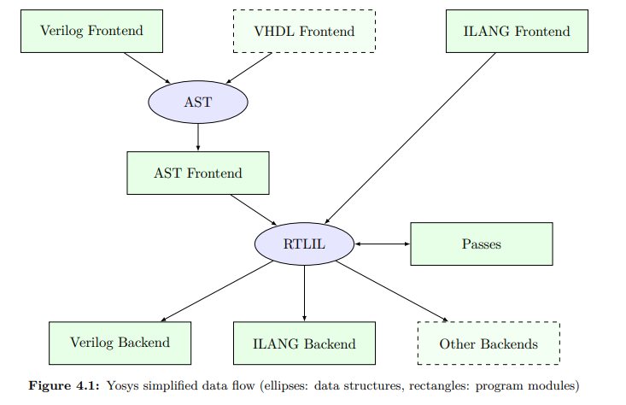
Implementation Overview
Design data is read in using one of the frontend modules.
The high-level HDL frontends for Verilog and VHDL code generate an abstract syntax tree (AST) that is then passed to the AST frontend.
The AST Frontend then compiles the AST to Yosys’s main internal data format, the RTL Intermediate Language (RTLIL).
Finally the design in RTLIL representation is converted back to text by one of the backends

Slide 7
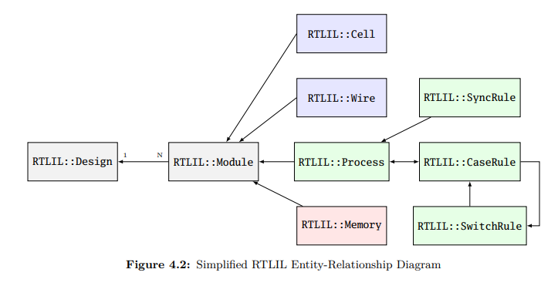
RTIL, just need to take an overview

Slide 8
Self-Study
Quickly go through Chapter 8
See what are different types of optimizations doing.

Slide 9
Using examples folder from the OSS-CAD-Suite Installation
Go to examples folder and quickstart folder
Launch:
Yosys demo.sv <enter>
This will open a new terminal and would read in the Verilog of demo.sv which has a simple 6-bit counter
Note that you have <yosys> shell now.
Execute:
Hierarchy –check –top demo <enter>
This will set top module as demo

Slide 10
Getting used to using examples
Execute
proc <enter>
This converts processes into netlist
It will find different constructs in the code and would convert it into hardware
Muxes
DFF
Memories
Latches
Read the messages given by proc carefully.
Complicated logic is still part of processes.

Slide 11
Dot File and GraphViz
Use the show command to convert the synthesized logic into a .dot graphical representation.
Show demo
This will write demo.dot
Install GraphViz 64-bit Windows from the following link:
https://graphviz.org/download/
Select all options
Using a command prompt, go to the folder demo.dot was generated, run the following command to generate an graphical SVG file:
Dot –Tsvg demo.dot > demo.svg
Open the demo.svg file in Web browser. This will show complete graphical dataflow of your logic.
Analyze that in detail.

Slide 12
Moving to FIFO from the Examples Folder
Move to /examples/fifo folder
Reset the design
Design –reset
Read Fifo (follow the complete example from repo link above)
Read_Verilog fif.sv
hierarchy -check -top fifo
Proc
Generate fifo.dot and convert to svg and open in web browser

Slide 13
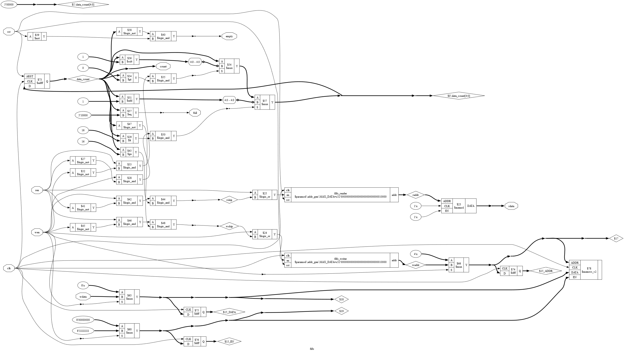

Slide 14
Observe the following in fifo.svg
The highlighted fifo_reader block contains two instances of the addr_gen module, fifo_reader and fifo_writer. Notice how the type is shown as $paramod\\addr_gen\\MAX_DATA=s32'.... This is a “parametric module”: an instance of the addr_gen module with the MAX_DATA parameter set to the given value.
The other highlighted block is a $memrd cell. At this stage of synthesis we don’t yet know what type of memory is going to be implemented, but we do know that rdata <= data[raddr]; could be implemented as a read from memory.
Also see that en and clock of $memrd are 1’bx so its not getting implemented as a memory block.
Observe RTIL names are marked with $.

Slide 15
Optimization Commands
We now flatten the design to allow optimization between the modules, so far the module boundary has been preserved.
flatten
Observe the svg again and comment on the difference before flatten command.
Self-Study : Send me back the differences you find.

Slide 16
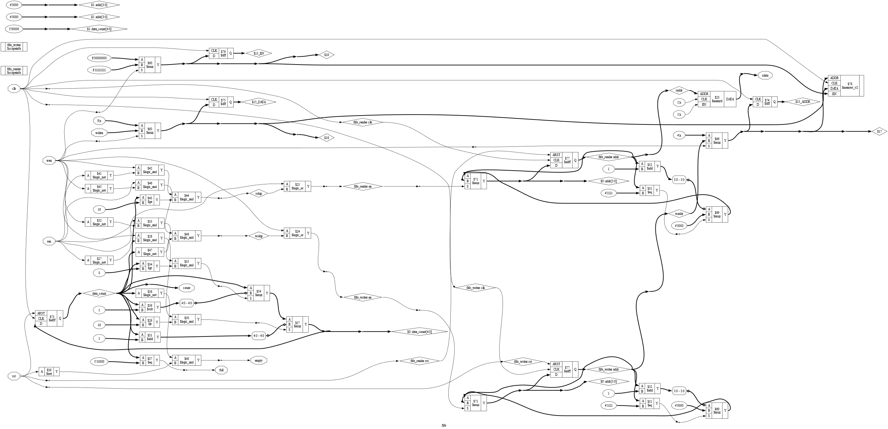

Slide 17
Run the following now:
Clean or opt_clean
To remove the unused modules.
Observe svg again.
Submit what differences you observe now.

Slide 18
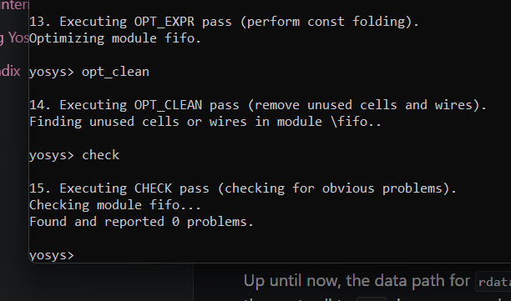
Further Optimizations
Opt_expr
Opt_clean
Check
Opt –nodffe –nosdff
Fsm
Opt
opt -nodffe -nosdff performing a set of simple optimizations on the design. This command also ensures that only a specific subset of FF types are included, in preparation for the next command: fsm - extract and optimize finite state machines. Both opt and fsm are macro commands which are explored in more detail in Optimization passes and FSM handling respectively.

Slide 19
Up until now, the data path for rdata has remained the same since rdata output after flatten;;. However the next call to opt does cause a change. Specifically, the call to opt_dff without the -nodffe -nosdff options is able to fold one of the $mux cells into the $adff to form an $adffe cell; highlighted below:
SS : The online example claims the above, carefully traverse through your SVG to observe if that has actually happened.

Slide 20
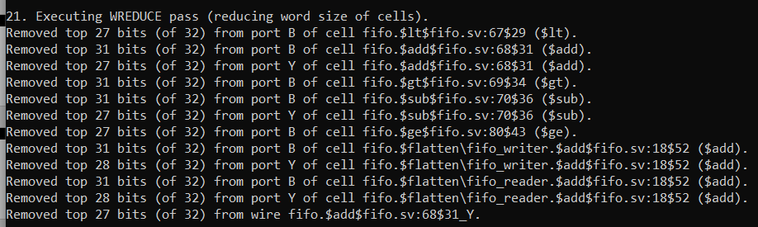
Further Optimizations
Wreduce
wreduce - reduce the word size of operations if possible. If we run this we get the following:
Use the following to generate svg again
show -notitle -format dot -prefix rdata_wreduce o:rdata %ci*

Slide 21
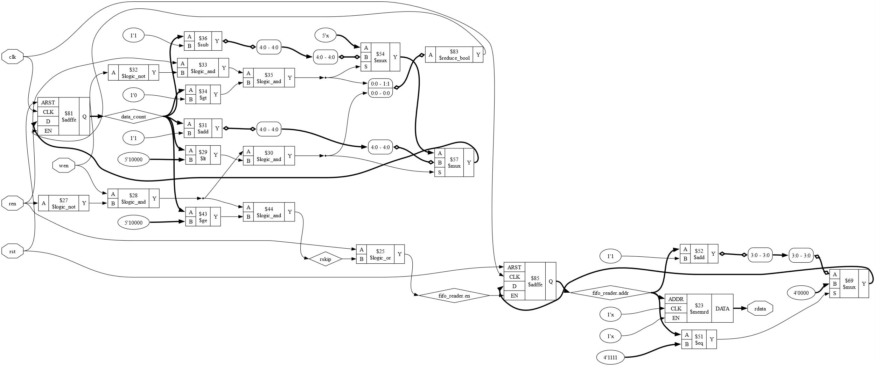
Understand what has been optimized and submit your feedback as part of class feedback

